Slide 1
COVID-19: API Interaction
Researchers: Jake Byford, George Hyros, Rob Peron, Michael Seifer, Narender Sharma

Slide 2
Do the following demographic factors have any effect on the spread of Covid-19 and the rates of death caused by the virus?
Median Household Income
Per Capita Income
Population Density
Age

Slide 3
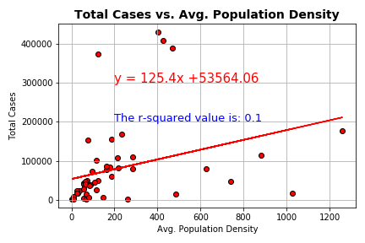
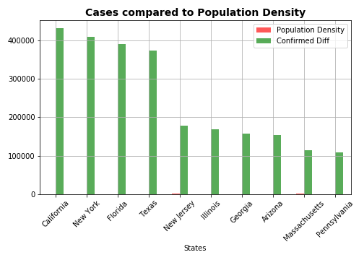
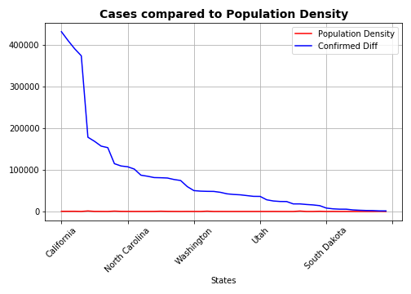
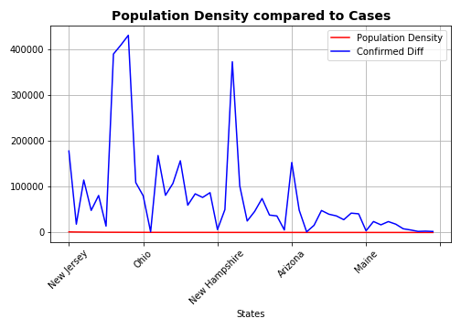
Does Population density IMPACT Cases?

Slide 4
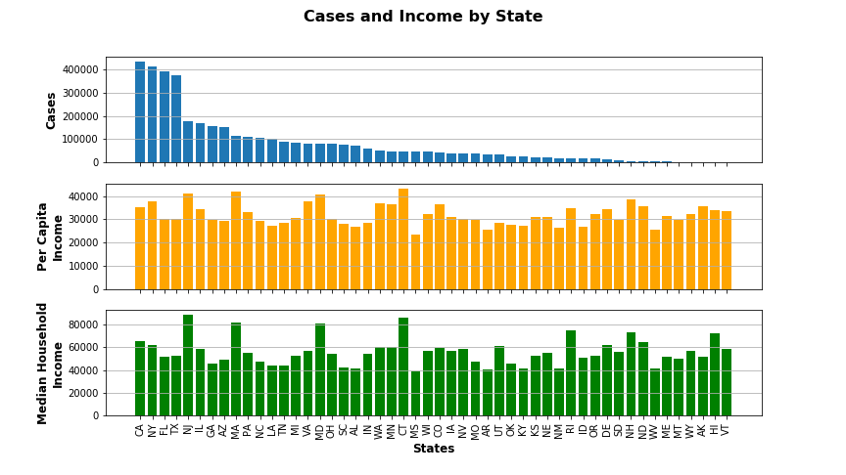
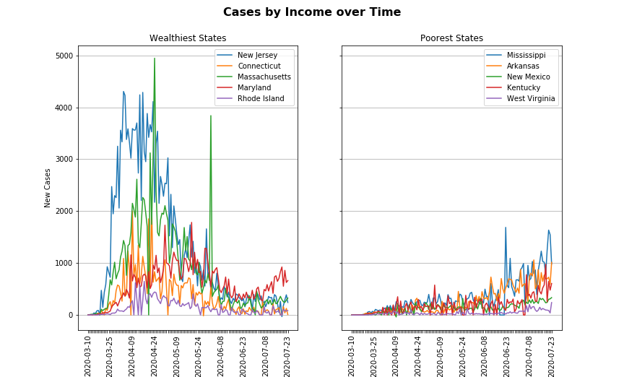
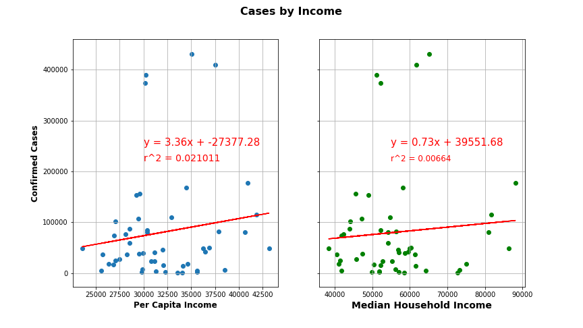
Does Income Impact NUMBER OF Cases?

Slide 5
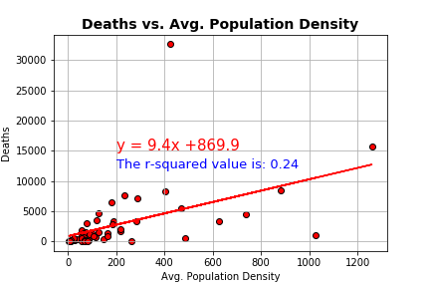
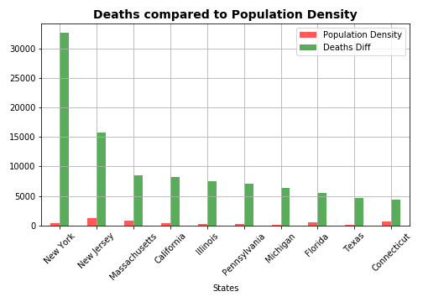
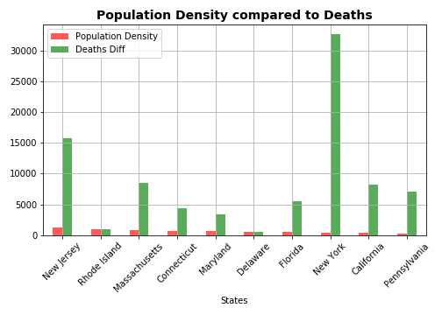
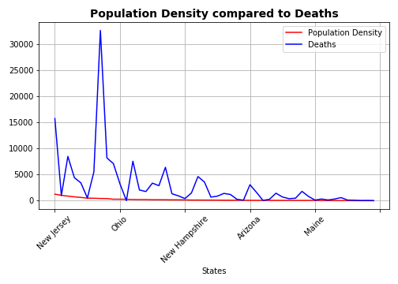
DOES POPULATION DENSITY IMPACT DEATHS?

Slide 6
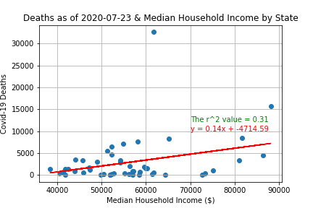
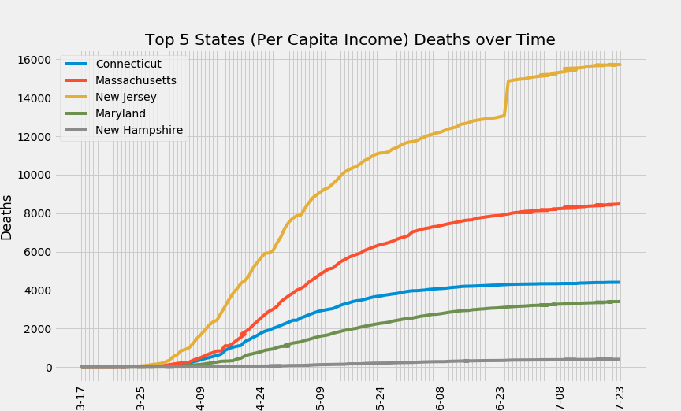
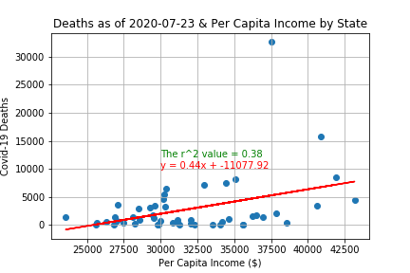
Does Income Impact NUMBER OF DEATHS?

Slide 7
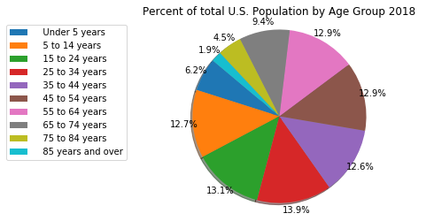
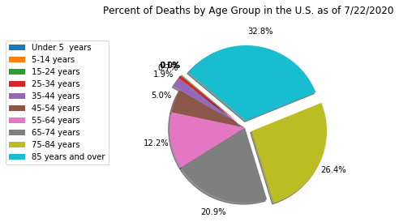
Percentage of Deaths by Age group vs. the General Population
This shows that over 59% of all deaths in the United Sates from COVID-19 were people aged 75 or older compared to the general population that represents only 6.4% of the total. Therefore, age plays a big factor in rates of death.

Slide 8
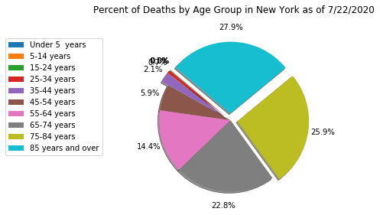
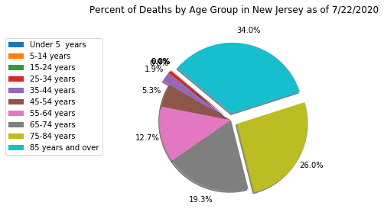
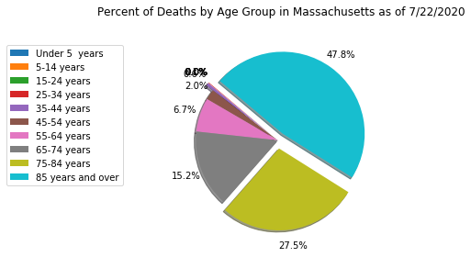
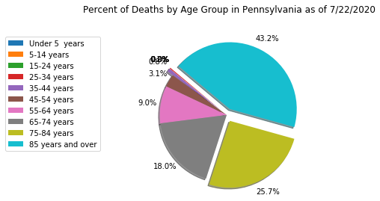
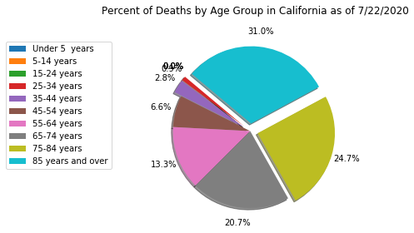
Percentage of Deaths by Age Group: Five Highest States
We see that the trend is consistent. Death rates increase with age.

Slide 9
In Conclusion
Median Household Income had a statistically insignificant impact on the number of cases.
Per Capita Income had some moderate correlation which suggests further analysis is warranted.
Population Density had a weak correlation between Deaths and Cases.
Age had the greatest impact among our studies. Death rates increased with age.

Slide 10
Data Sources
www.census.gov (U.S. Census Bureau)
https://data.cdc.gov/NCHS/ (Center for Disease Control and Prevention)
https://pypi.org/project/uszipcode/ (Used to convert Zip Codes from Census to County and State)
https://pypi.org/project/us/ (Used to clean up junk state data from cases on cruise ships)
https://covid-api.com & https://rapidapi.com/search/covid
(Based on public data by Johns Hopkins CSSE)
THANK YOU

